Slide 1
The Innovation Crew
Jackson Fentress
Braydon Laughner
Savannah James
Maria Martinez
Jonathan Tran
Nathan Bearden

Slide 2

Summary
Surgery on Sunday is a growing non-profit organization with over 500 volunteers and 200 patients
Problems:
Data Storage
Donations
Language Barriers
Social Media
Patient Testimonials
Notes:
SOS is a growing non profit organization - over 500 volunteers/ 200 patients - great but has created large problem with manually entering information
Volunteers have very little time which means they need an efficient system to collect information so they can spend their time writing grants/ collecting donations
SOS Louisville receives large amounts in donations every year. However, Paypal takes 2.2% ($22 per $1000 donated) + $0.30 per transaction in fees. Alternate donation methods can help SOS retain donations that can be spent on patients (transportation to the surgery, hotel stay, etc)

Slide 3
Data Storage
PROBLEM STATEMENT
Current system of collecting and storing data can be greatly improved.
Their data is currently spread out across several Excel files.
The patient application forms are not accessible to patients and a password is needed to fill one out.
SOLUTION
Create a database system that will automatically set up events.
Make the patient referral process simpler.
Notes:
I’ve included a rough draft of what I’m going to try to say. This obviously could change because I won’t be reading off of a sheet, but these are the ideas I’m trying convey and how I’d like to convey them.
Introduction I’m going to be talking about the problem that Surgery on Sunday has with their data storage.
Problem
1. Their current system of gathering and storing data (like volunteer, patient, and donor information) is not optimal.
a. The first issue is that they currently gather the data from the website and store it across several Excel Spreadsheets.
i. This makes it very laborious for employees like Barbara to create events or to find pertinent information.
b. Another problem with their system is that their patient referral tab is currently protected by a password that is only available to medical personnel.
i. This may prohibit Surgery on Sunday from treating some patients.
Solution
1. Our solution to the first problem would be to create a database system that will automatically create events as data is entered into the system. Another goal of this system will be to make it much easier to navigate.
a. This will create value because it will save Barbara time; and Barbara can use this extra time to write more grants, raising SOS’s cash flow.
2. Our solution to the second problem would be to create a system which makes the patient referral process much simpler for the user.
a. This will increase the amount of patients that Surgery on Sunday can treat.
b. This creates value because treating patients is one of the core processes for Surgery on Sunday.
Now, I’m going to throw it over to Jackson, and he’s going to talk about the patient testimonials.

Slide 4
Patient Testimonials
PROBLEM STATEMENT
Surgery on Sunday does not include any form of testimonials on their website
Potentially causes donors to donate a smaller amount
Could deter potential donors from donating to the organization at all
SOLUTION
Gather and include patient testimonials to include on the donation page
Organizations that utilize customer testimonials see 3x the amount of traffic
(Journal of Marketing Research)
More people donate to the organization overall
Will motivate donors to donate in larger amounts
Makes it possible for Surgery on Sunday to operate at a higher capacity
Notes:
When researching similar organizations to Surgery on Sunday, we found that most of them included patient testimonials on their site. Surgery on Sunday Louisville was one of the few that didn’t. We believe that this could cause people to either donate in smaller amounts or could potentially deter people from donating to the organization at all. Without patient testimonials, the organization loses the opportunity to cause the potential donor to become emotionally invested in their donation. Our solution would include gathering patient testimonials from previous clients and including them with the donation page on the website. This could motivate donors to donate in larger amounts and could motivate more people to donate to the organization overall. This will result in Surgery on Sunday being capable of performing more surgeries, having more events, and possibly expanding their organization to different regions.

Slide 5
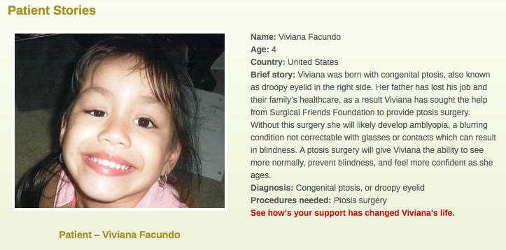
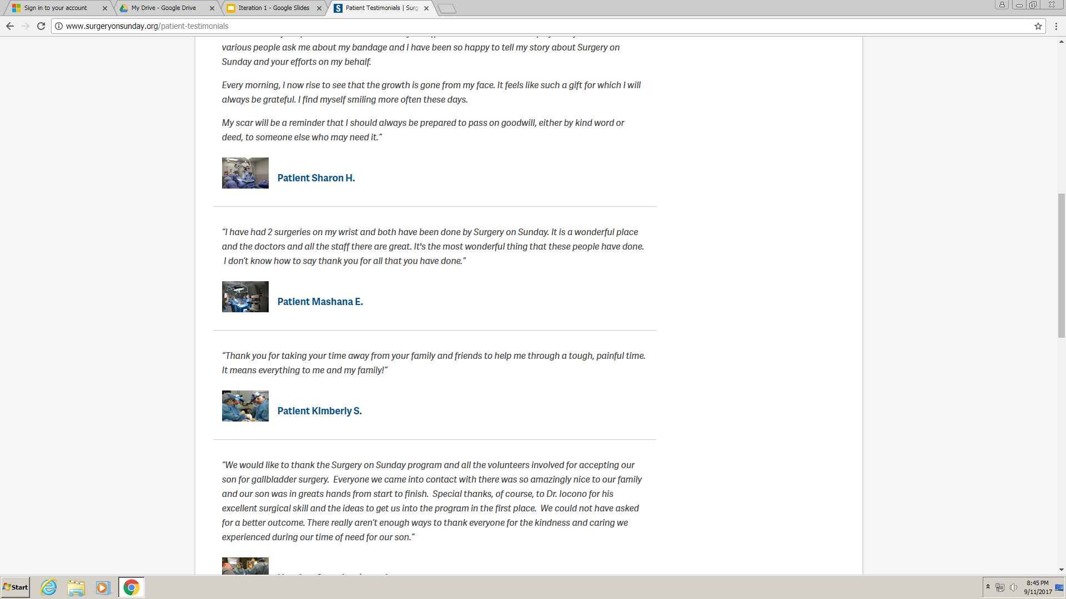
Patient Testimonials
(Surgical Friends)
(Surgery on Sunday - Lexington)
Notes:
These are a few examples of patient stories and testimonials from similar organizations. The example on the left is an example of a patient story before they have received treatment. This technique could encourage more people to donate because it attaches them to the organization’s cause and tells them that they can make a difference in someone’s life. The example on the right is from Surgery on Sunday Lexington. Their testimonial is from the patient after their surgery. This type of testimonial shows the potential donor that what they organization doing is making real impacts on people’s lives. This could encourage them to donate knowing that they can help the organization assist more people.

Slide 6

Donations
PROBLEM STATEMENT
Surgery on Sunday relies on donations to successfully operate their organization
There are more efficient ways to collect donations
PayPal takes 2.2% + $0.30 out of every donation
No option for recurring donations
Difficult to keep track of donor information
No patient testimonials or information as to where donations are going
SOLUTION
Incorporate the use of patient testimonials and update the donation method
Include specific donation amounts and describe what the money will be used for
Notes:
This slide will explain the problems that SOS has with donations. They find it hard to keep track of donors information (cannot properly thank them, ask for more money, etc.) Website lacks an efficient way to collect donations - (donation fee that paypal takes out - 2.2% + $0.30 of each nonprofit donation ((donations out of country are 5.4% -- problem if they keep expanding like barbara said they were))) ** find out typical donations they get from paypal - calc how much paypal has kept ***
Website does not have a way to spread word about what your donations may go to (may convince some to donate)
Recurring donations
Promote fundraising events
Grants
*******share button on soslouisville doesnt share website - shares share button *****
BUSINESS CASE
The value added in this solution is that SOS employees will have more time to write grants.
The specific value added would be: Include calculation based on grant information.
So, the cause of creating a system that automatically sets up events will have an effect of generating more revenue through grants because Barbara will have more time to write grants.

Slide 7
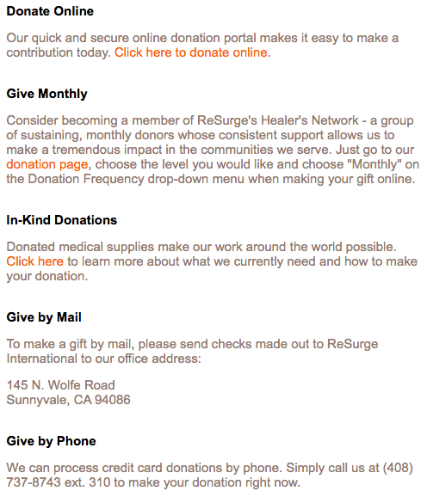
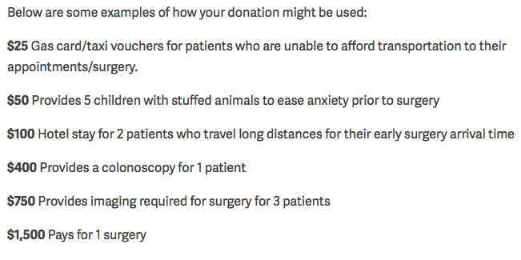
Donations
Surgery on Sunday (Lexington) Donations
Notes:
The value added to this solution is that SOS will be able to expand their donor audience and retain donations that would normally go towards fees.
The specific value added will be: Include calculation based on donation information.
The cause of an alternate donation method with lower fees will have an effect on the retention of donations that can be used towards patients.
Transportation to hospital (taxi vouchers)
Hotel stay for patients out-of-state

Slide 8
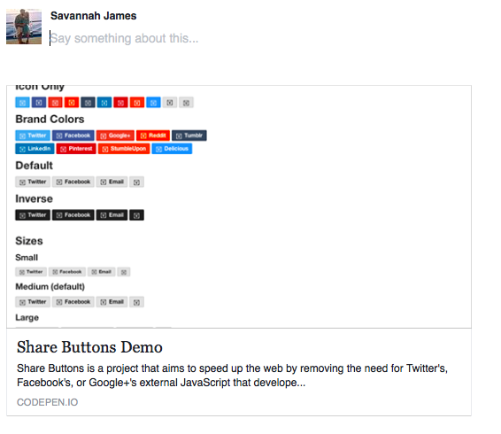
Social Media
PROBLEM STATEMENT
Surgery on Sunday lacks optimal social media presence
Potentially does not reach out to a wider range of audience that SOS would like
SOS’s social media sharing button has a malfunction
Solution
SOS’s social media button should link directly to home page of website
Send out a newsletter to keep donors/others interested in events and fundraising opportunities
Create more of a social media presence on other platforms besides Facebook
Post regularly to gain a following and continue to inspire others to give
Notes:
-do have facebook/twitter
-present on facebook but not on other social media
-could do patient testimonial of the week/month and could impact emotionally and create more shares
-create more events that would allow people to come and donate
Create a share button that allows everyday people to raise awareness for SOS on their respective social media accounts

Slide 9
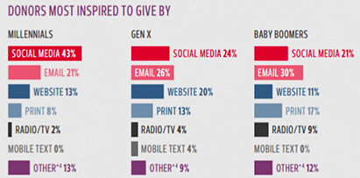
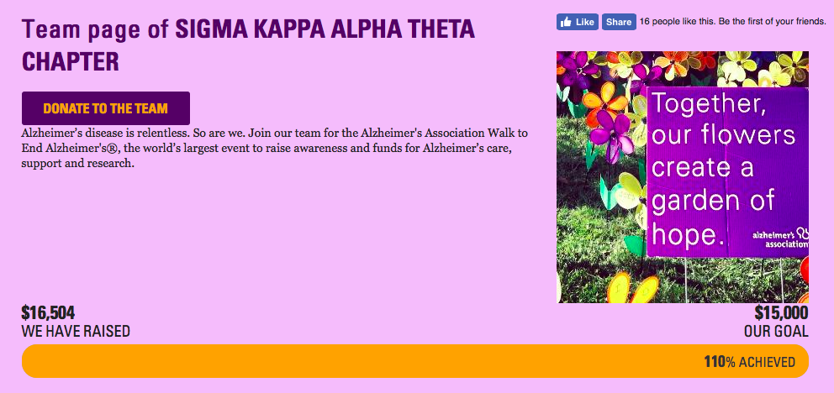
Social Media
Notes:
Just from shares on facebook/twitter/ig and asking others, UOFL SK raised over 16,000 for the walk to end alz
http://www.nptechforgood.com/2016/05/13/16-must-know-stats-about-online-fundraising-and-social-media/

Slide 10
Language Barriers
PROBLEM STATEMENT
Only offers an English language option on their website
Prevents potential clients from gaining access to their services
SOLUTION
Include a Spanish option (73% of Surgery on Sunday’s client’s speak Spanish)
Notes:
By adding additional language options on their website, SOS would be able to bring in more potential clients as well as showcase how they cater to those who do not speak english as their first language. It is not mentioned on their website but they do have interpreters. Knowing this and seeing how they are working to overcome the barrier could make weary clients more comfortable by knowing that someone can understand their problems and be there for their surgery.

Slide 11
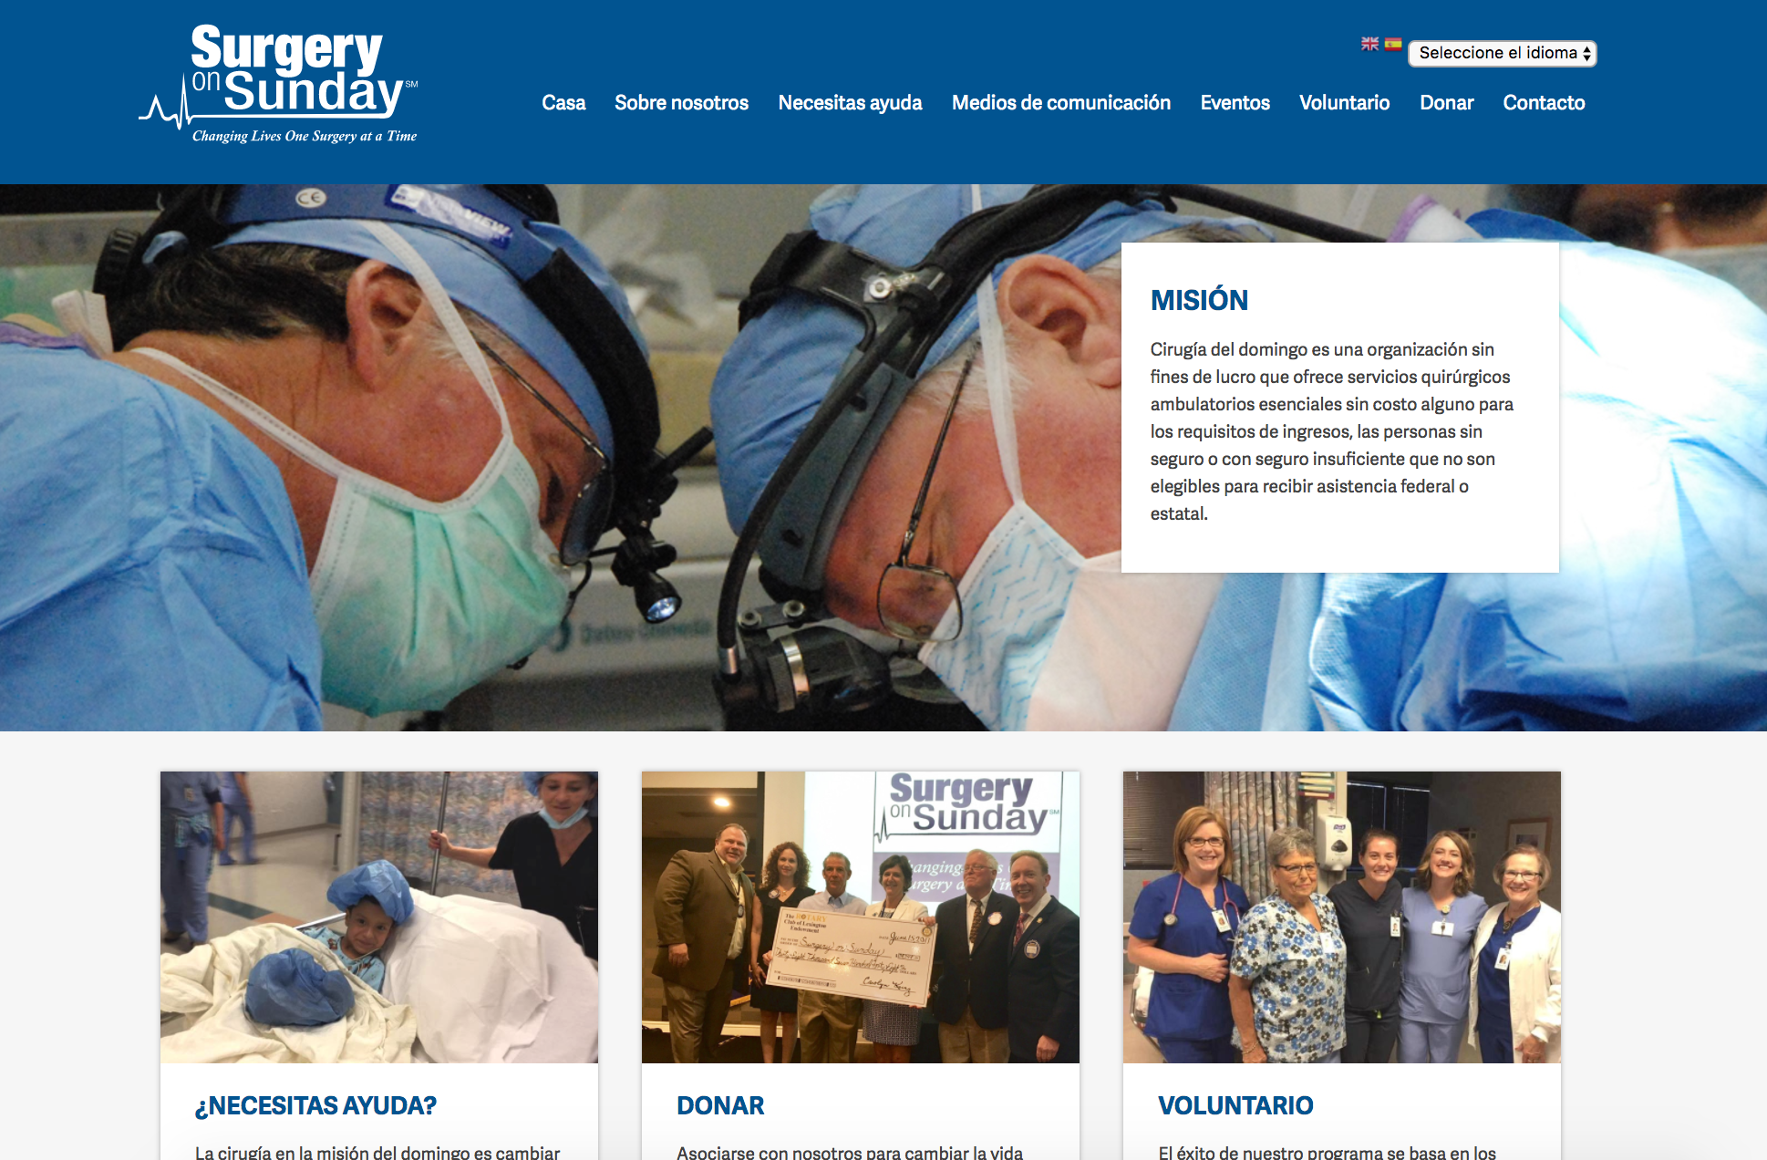
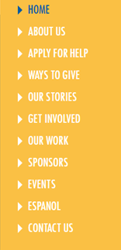
Language Barriers

Slide 12
Conclusion
We believe that the organization will benefit greatly by fixing these problems.
Problems:
Data storage
Donations
Language
Social Media
Patient Testimonials

Slide 13
Questions?

